Slide 1
HR Analytics

Slide 2
Introduction
A Human Resources (HR) Officer is responsible for managing every aspect of the employment process, including orientation and training new staff members. They also assist with payroll management, so employees receive their paychecks on time.

Slide 3
Details of Data
Data Collection
Gather all relevant data on employees, including:
Demographics (age, gender, education, etc.)
Employment details (department, role, tenure, salary, etc.)
Performance data (performance reviews, productivity metrics, etc.)
Exit interviews and surveys (reasons for leaving, feedback, etc.)
Attendance records (absenteeism, leaves, etc.)
Engagement scores (employee satisfaction surveys, engagement metrics, etc.)

Slide 4
Main KPIs
Overall Attrition Rate
Attrition by Department and role
Attrition by Age Group
Attrition by Gender
Attrition by Education Level
Tenure Analysis

Slide 5
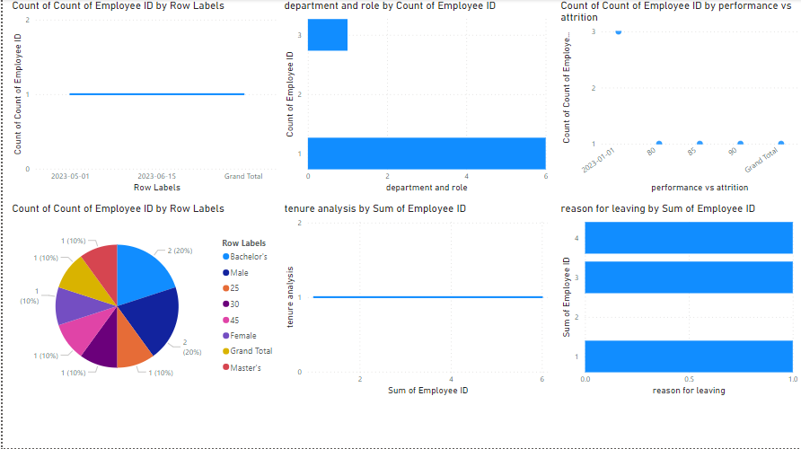
Dashboard

Slide 6
Thank you

